Slide 1
Diseño de software
Ing. Jonathan solis parajeles
itcr

Slide 2

Designing Experiences That Work
Why UX/UI Matters
UX Principles
UI Principles
The UX/UI Workflow in Software Design
Common Pitfalls

Slide 3
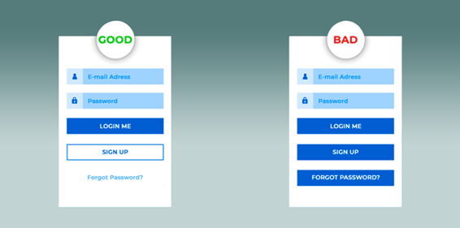
Why UX/UI matters
88% of online users won’t return after a bad experience.
Good design improves engagement, conversions, and loyalty.
UX/UI can be your biggest competitive advantage.

Slide 4
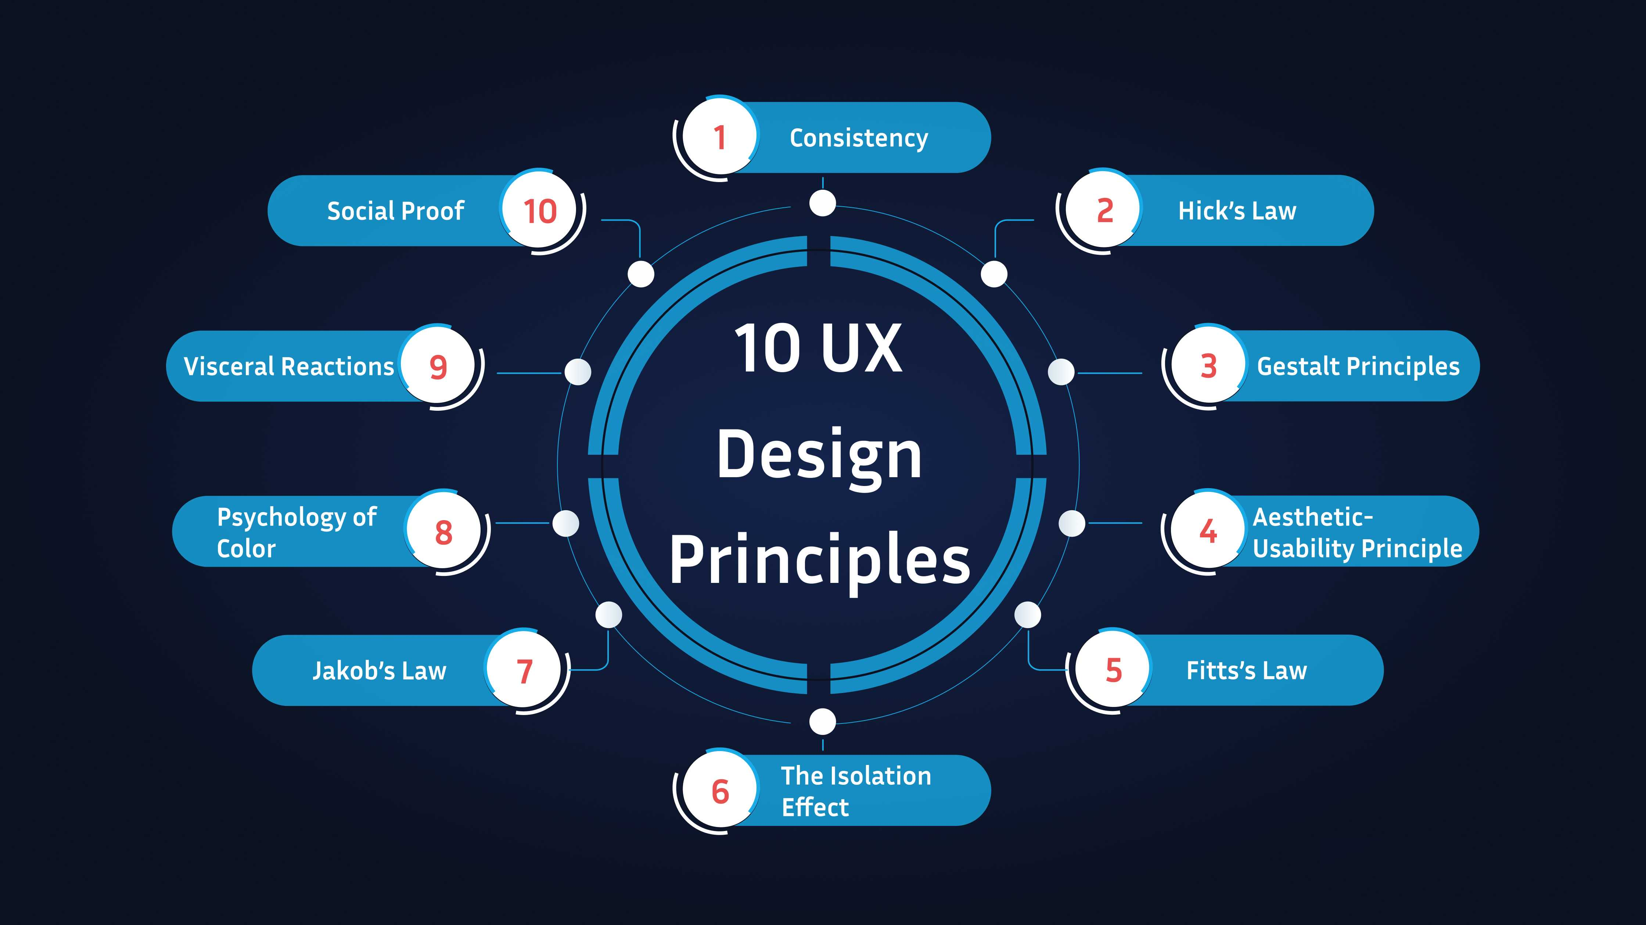
UX Principles
Clarity: Users instantly understand what to do.
Consistency: Predictable patterns build trust.
Accessibility: Inclusive design works for everyone.
Real-World Mapping: Interfaces match how people think.
Notes:
Hick’s Law 🕒 The more choices you offer, the longer it takes for users to decide — keep it simple.
Gestalt Principles 🔍 Users naturally group and interpret elements as a whole, not just as separate parts.
Fitts’s Law 🎯 The bigger and closer a target, the faster and easier it is to hit.
Jakob’s Law 📚 Users expect your design to work like the sites and apps they already know.

Slide 5
UI Principles
Visual hierarchy guides attention.
Feedback shows system response.
Alignment with brand identity.
Responsive layouts adapt to devices.

Slide 6
The UX/UI Workflow in Software Design
Research & user personas.
Wireframes & low-fidelity prototypes.
Usability testing & iteration.
Design handoff to developer.

Slide 7
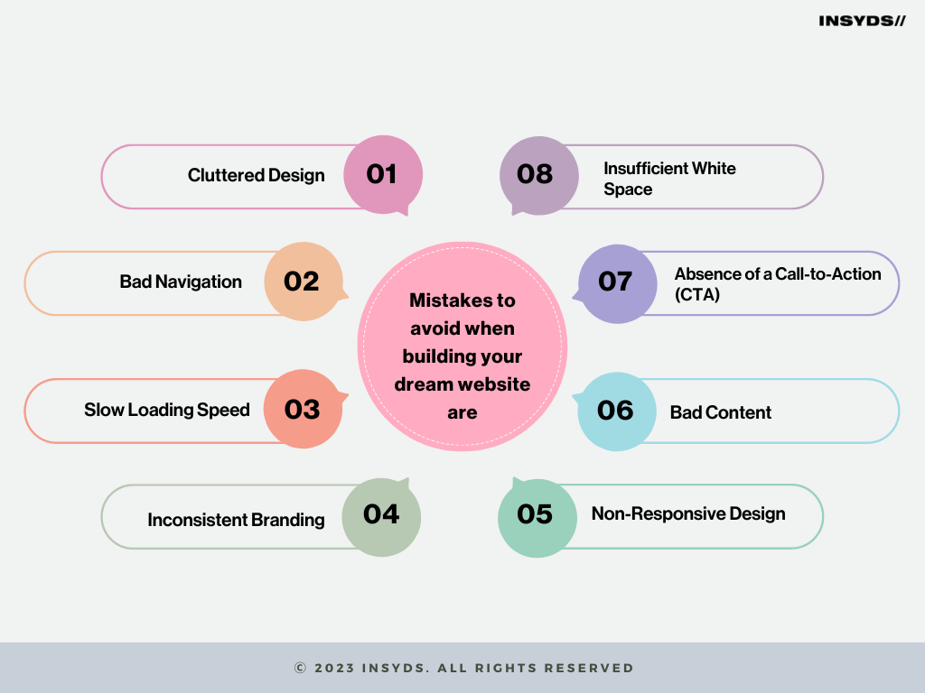
Common Pitfalls
Overcomplicating the interface
Inconsistency across screens
Neglecting accessibility
Skipping usability testing
Notes:
"Most design failures aren’t due to lack of creativity — they’re due to skipping fundamentals."

Slide 8
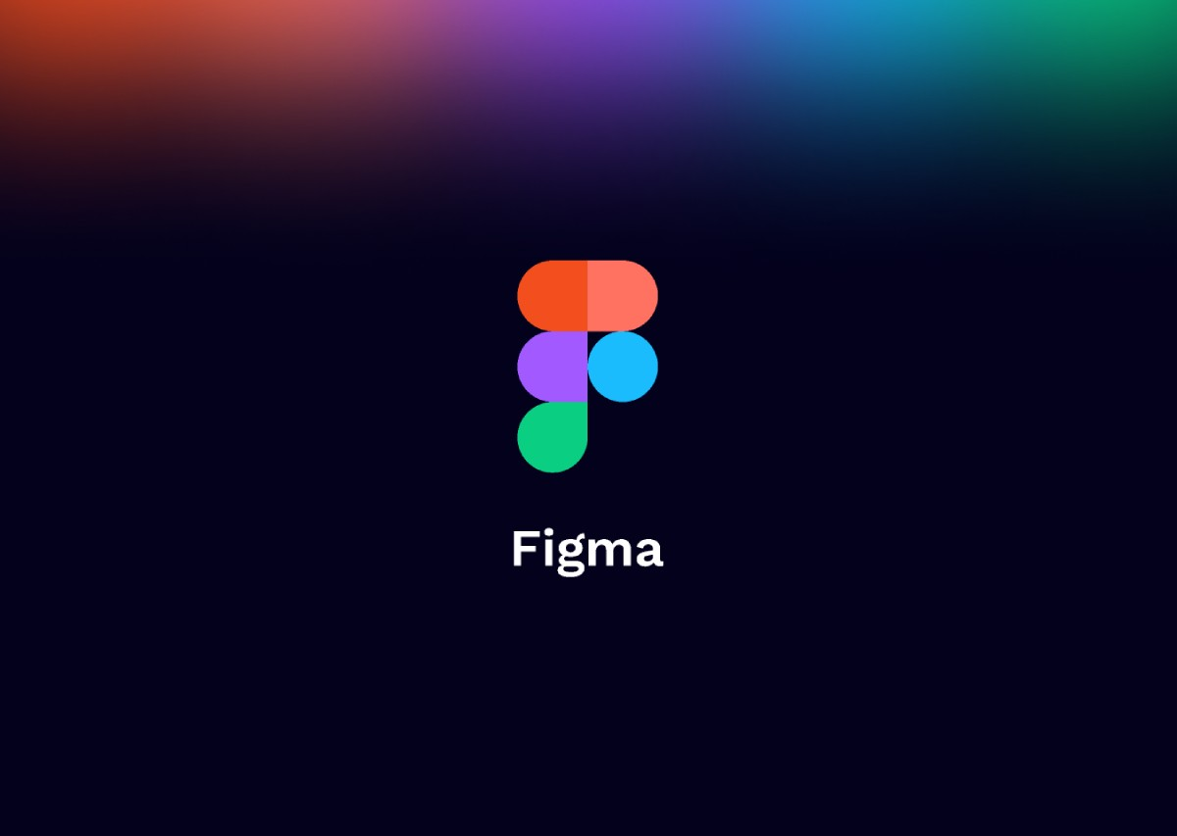
Figma

Slide 9
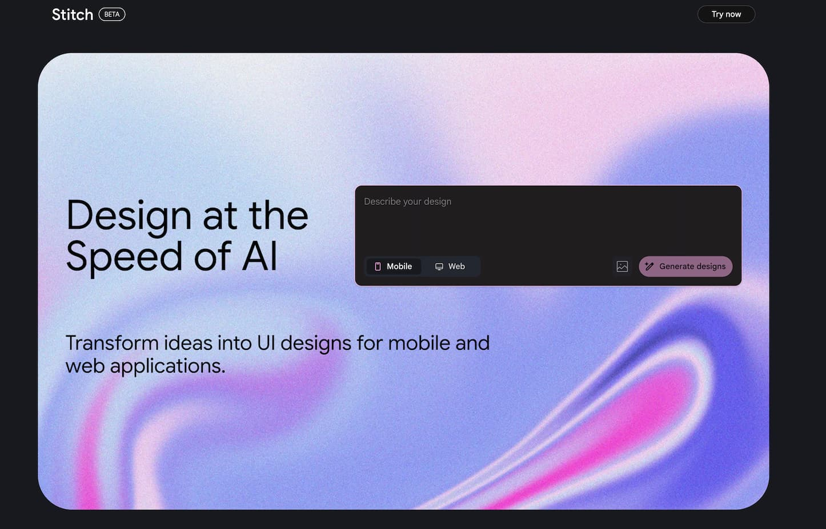
Stitch

Slide 10
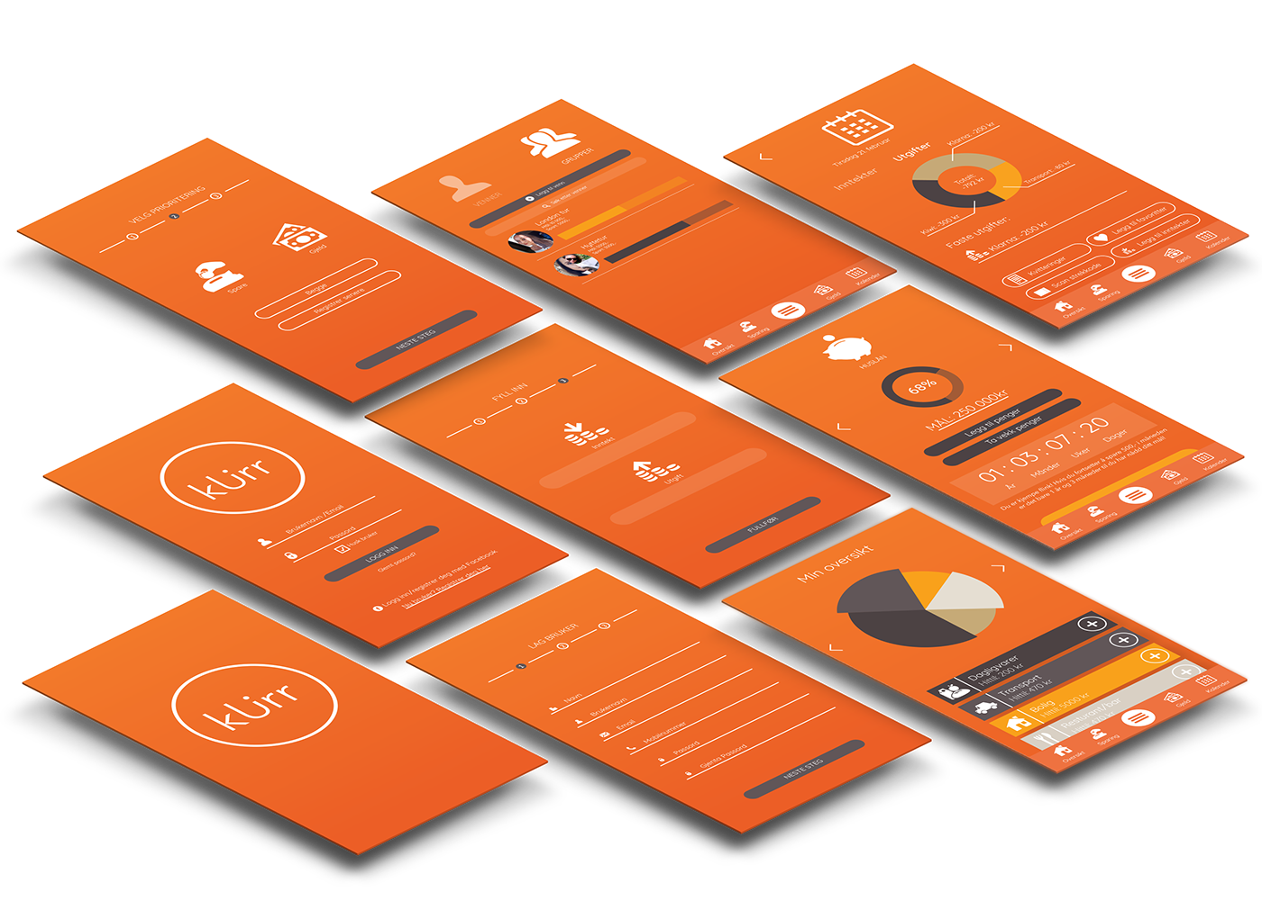
Workshop
Name tech products you love (or hate) and why
Pick one relatable tech theme (app / software)
Sketch a proto-persona (Demographics, pain points, scenarios)
Sketch the idea and vote!

